Slide 1


Sugar CRM – Application Testing

Slide 2
Know about Kapitus Business

Slide 3
Test Automation
Approach | Architecture

Slide 4
Test Automation Roadmap & Approach
Once the Manual testing process is established and stabilized, we would recommend building an automation test platform that would improve overall efficiency of the testing process.
Automation Testing
Prepare an Automation test Plan
Identify Automation test Coverage
Build a automation testing framework for SugarCRM System
Develop automated test cases in the framework
Use the Automation scripts for regression testing
Issues summary, Logs, Reports can be triggered without manual intervention

Slide 5
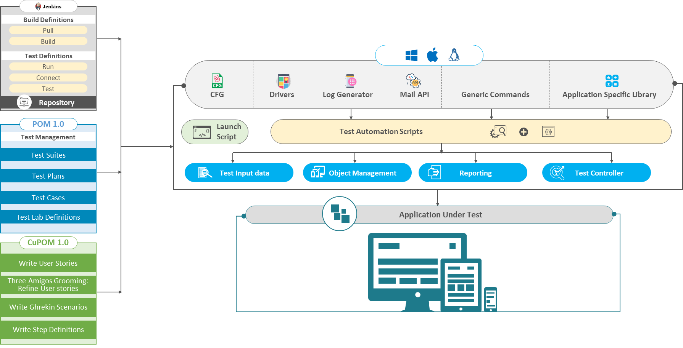
Automation Test Architecture

Slide 6
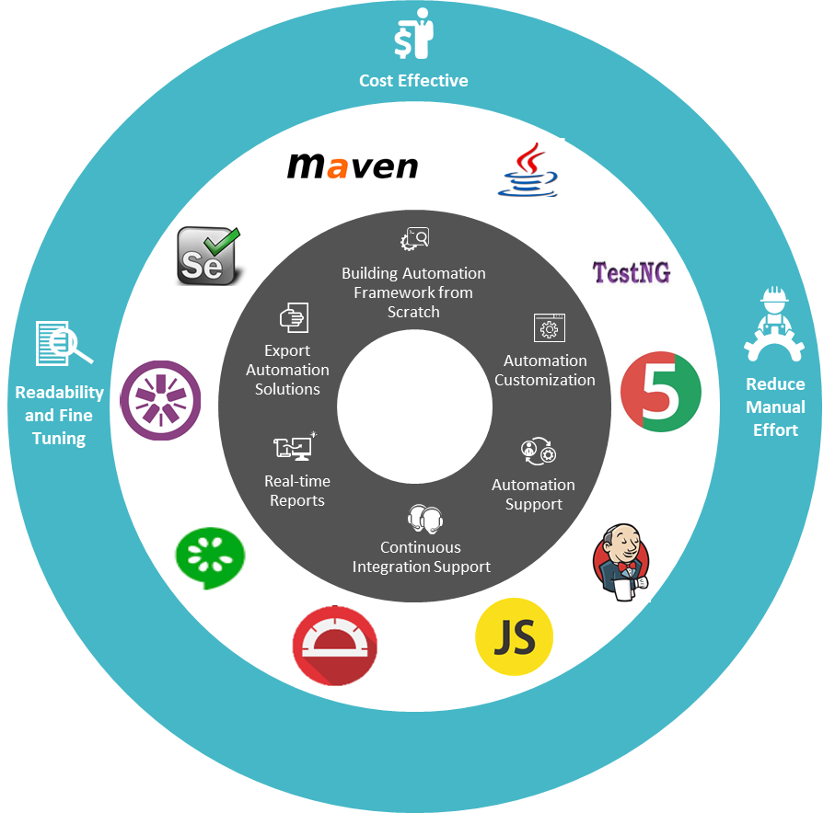
Our Test Automation Excellence

Slide 7
Challenge we face

Slide 8
Effort Distribution Sampling
Approximate Effort Distribution
Activity | % | Estimated Hours/Month
Requirement Anaylsis | 15% | 75
Impact Analysis | 5% | 25
Test Planning | 5% | 25
Test-Case Design | 5% | 25
System Testing | 25% | 125
System Integration Testing | 15% | 75
Funtional Testing | 5% | 25
UAT | 5% | 25
Re-testing | 5% | 25
Regression Testing | 10% | 50
LIVE Production Testing | 5% | 25
Total Hours |  | 500
Sampling- Effort Estimation
Ticket Type | Hours/month | Average # of tickets
 |  | 10-15
New Features | 250 | 3 to 5
Enhancements | 150 | 3 to 5
Existing issue fixes | 100 | 4 to 5

Slide 9
Return On Investment
Month | Manual Testing Time (Hrs) | Test Automation Execution Time Per Release (Hrs) | No. Automated Runs Per Month | Gain | Cost |  |  | ROI = (Gain - Cost) (Hrs)
 |  |  |  | Savings from Automation Run (Hrs) | Initial Time for Build Test Automation (Hrs) | Test Automation Maintenance Time (Hrs) | Analyse the Result from the Test Automation (Hrs)
Aug '19 | 160 | 0.93 | 2 | 1.86 | 480 | 0 | 0 | -321.86
Sep '19 | 160 | 0.93 | 2 | 1.86 | 0 | 0 | 0 | 158.14
Oct '19 | 160 | 0.93 | 2 | 1.86 | 0 | 0 | 0 | 158.14
Nov '19 | 160 | 0.93 | 2 | 1.86 | 0 | 0 | 0 | 158.14
Dec '19 | 160 | 0.93 | 2 | 1.86 | 0 | 0 | 0 | 158.14
Jan '20 | 160 | 0.93 | 2 | 1.86 | 0 | 0 | 0 | 158.14
Feb '20 | 160 | 0.93 | 2 | 1.86 | 0 | 0 | 0 | 158.14
Mar '20 | 160 | 0.93 | 2 | 1.86 | 0 | 0 | 0 | 158.14
Apr '20 | 160 | 0.93 | 2 | 1.86 | 0 | 0 | 0 | 158.14
May '20 | 160 | 0.93 | 2 | 1.86 | 0 | 0 | 0 | 158.14
Jun '20 | 160 | 0.93 | 2 | 1.86 | 0 | 0 | 0 | 158.14
July '20 | 160 | 0.93 | 2 | 1.86 | 0 | 0 | 0 | 158.14

Slide 11
How we’re going to concentrate automation TCOE

Slide 12

1701 E Woodfield Rd, Suite
710 Schaumburg, IL 60173
info@ameexusa.com

